Slide 1


Team : incognito
SECUREPASS: System
The Most Secure Airport Interview AI
An AI-powered Airport Security System

Slide 2



Problem Statement
Current airport security interviews are time-consuming and manual.
Prone to human bias and inconsistency.
Rising passenger traffic strains security resources.
Need for an automated, objective system that combines identity verification with behavioral threat detection.

Slide 3
Proposed Solution
SecurePass is an AI-driven interview system that:
Identity Verification: Uses biometrics (face + voice) for passenger authentication.
Interview Process: Conducts short interviews and flags passengers for human review if they make jokes or sarcastic remarks.

Slide 4
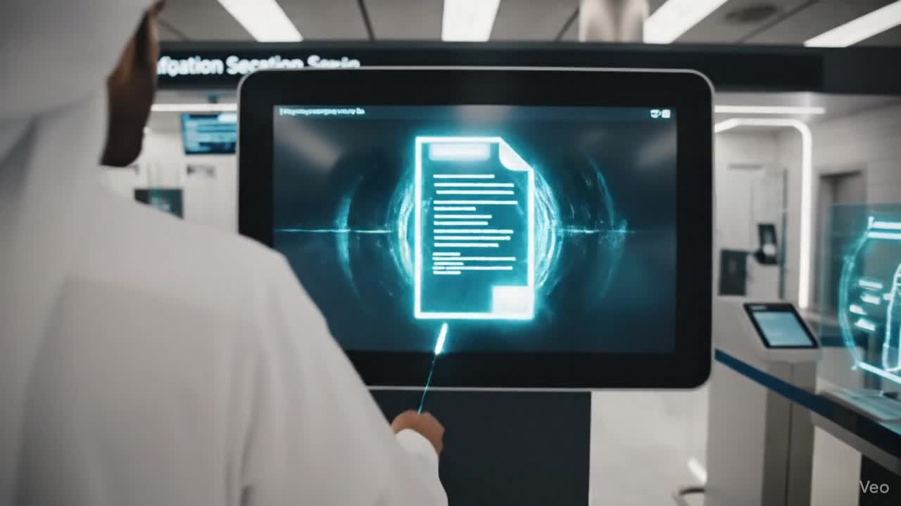
Demo

Slide 5
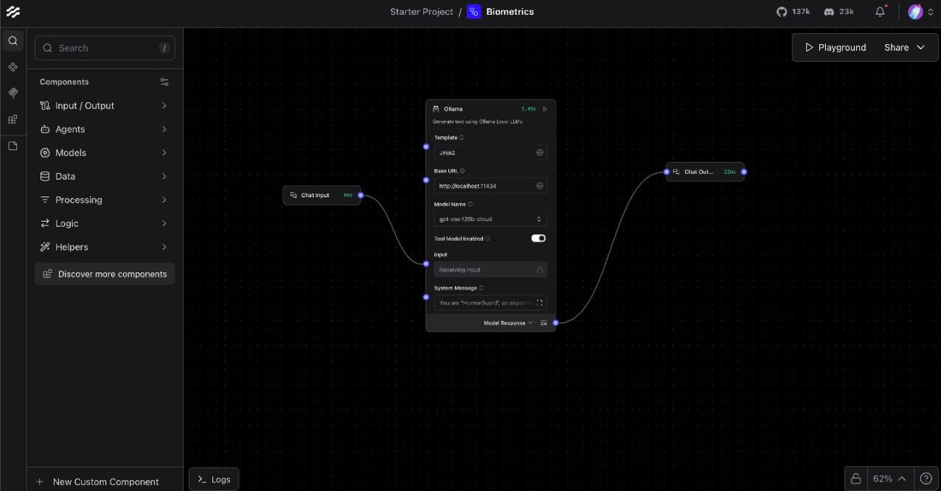
LangFlow Workflow

Slide 6




Results & Benefits
Improved Screening Efficiency: Faster processing without compromising safety.
Reduced Human Bias: Objective, consistent evaluations.
AI-Human Interaction Insights: Reveals limitations in contextual understanding by AI.

Slide 7





Business Aspect
Airports demand faster, smarter, secure passenger processing.
Reduces manpower costs, boosts verification accuracy, and enhances traveler experience.
Perfect fit for Al Maktoum International Airport (Dubai)—designed for 260M passengers/year with cutting-edge, contactless tech.

Slide 8


Conclusion
SecurePass merges biometric verification and AI-driven behavioral analysis to revolutionize airport security:
Automates identity checks & interviews
Reduces human workload & bias
Enhances passenger experience
As airports like Al Maktoum International embrace smart travel, SecurePass is the next step in intelligent, seamless security.

Slide 9
Thank You

